Slide 1
OpenCAI: Open Cloud AI
Group Member name: Atharva Bedekar, Janay Bhanushali, Sanidhya Solanki
Supervisor name: Dr. Ramakrishna Bandi
Date: 4th October, 2026
International Institute of Information Technology, Naya Raipur

Slide 2
Content
Introduction
Motivation: Issues and Challenges
Problem Definition
Research Gap
Objectives
Proposed Framework and Agent Execution Flow
Database Description
Experimental Results and Discussion
Conclusion and Future Directions

Slide 3
Introduction
OpenCAI is a white-label AIOps and FinOps platform: teams manage their cloud by chatting with an AI agent.
Operators ask in plain language to inspect resources, troubleshoot issues or analyse costs for a selected Workspace.
The agent proposes the exact cloud CLI command, explains it, and runs it in an isolated Docker sandbox.
Features:
  Two modes: AIOps (cloud operations) and FinOps (Tag Compliance, Cost Analytics, Waste Management, Cost Optimisation).
  Human approval: any command that changes resources runs only after the Operator confirms it.
  Administration: Organisations, Workspaces, Operators, model settings and branding are controlled by Administrators.
  Security: MFA sign-in, envelope-encrypted credentials and a full audit trail.

Slide 4
Motivation
Lower the skill barrier: cloud consoles and CLIs have thousands of commands; plain language is faster than memorising syntax.
Make cost visible: cost and usage data is spread across services, so waste and untagged resources go unnoticed.
Keep a human in control: an AI that runs commands on a live cloud account must not act on its own judgement alone.
Protect credentials: long-lived access keys shared between people and tools are a common source of leaks.
No open, controllable option: existing cloud assistants are proprietary, vendor-hosted and tied to one cloud and model; there is no open-source one a team can self-host, inspect and control.

Slide 5
Problem Definition/Problem statement
Operating a cloud account needs deep knowledge of provider consoles and CLIs, and cost data is hard to interpret.
LLM agents can translate plain language into commands, but letting a model run commands on a live account is unsafe: it can be wrong, or be manipulated.
Existing solutions are private: proprietary, vendor-hosted and single-cloud, so they cannot be inspected, self-hosted, scoped to client organisations or re-branded.
Problem: build a self-hosted, white-label platform where an AI agent performs cloud operations and cost analysis from chat, while every safety property is enforced by deterministic code around the model and not by the model itself.

Slide 6
Research Gap
Private products, no open source: several companies have built proprietary cloud assistants, but to our knowledge there is no open-source, self-hostable alternative.
No CLI-driven variant: to our knowledge, no existing assistant lets the agent drive the cloud CLI itself, the way a human operator would.
Safety is left to the model: agent frameworks such as ReAct have no deterministic check between a proposed action and its execution.
Operations and cost are separate: AIOps and FinOps tooling are distinct products; there is no single, audited, conversational interface covering both.

Slide 7
Objective (s) of the Project
Build a chat interface through which Operators run AIOps and FinOps tasks on a selected cloud Workspace.
Enforce a default-deny command policy in code: classify every proposed command as lookup, read-only, mutating or rejected.
Require explicit human confirmation before any command that changes resources, with a per-session cap.
Execute commands only inside isolated, non-root, short-lived Docker sandboxes with scoped credentials.
Secure the platform with TOTP-based MFA, envelope encryption (AES-256-GCM) for credentials and a full audit log.
Keep it open: multiple LLM providers, white-label branding, and a containerised, versioned release.

Slide 8
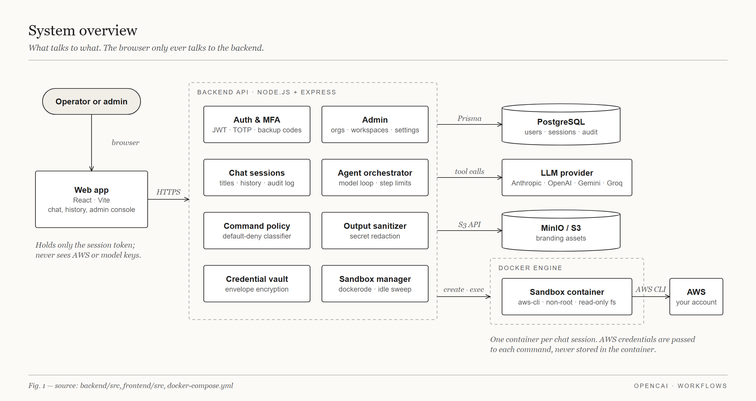
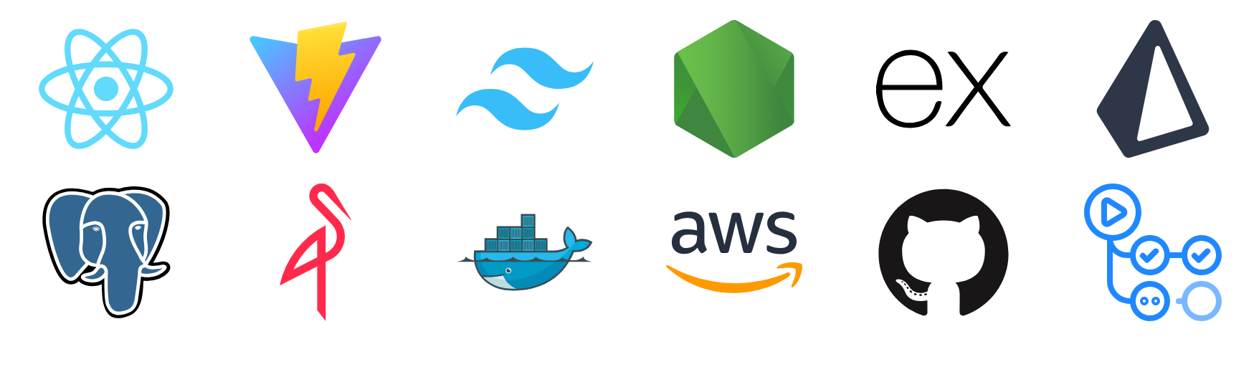
Proposed Framework/Methodology
Frontend: React, Vite, Tailwind CSS (PWA)
Backend: Node.js, Express REST APIs
Database: PostgreSQL with Prisma ORM
Object storage: MinIO / S3 (branding assets)
AI providers: Anthropic, OpenAI, Gemini, Groq, NVIDIA
Execution: Docker sandbox with pinned AWS CLI
Security: JWT, TOTP MFA, AES-256-GCM envelope encryption, audit log
DevOps: Docker Compose, GitHub Actions, semantic-release, GHCR

Slide 9
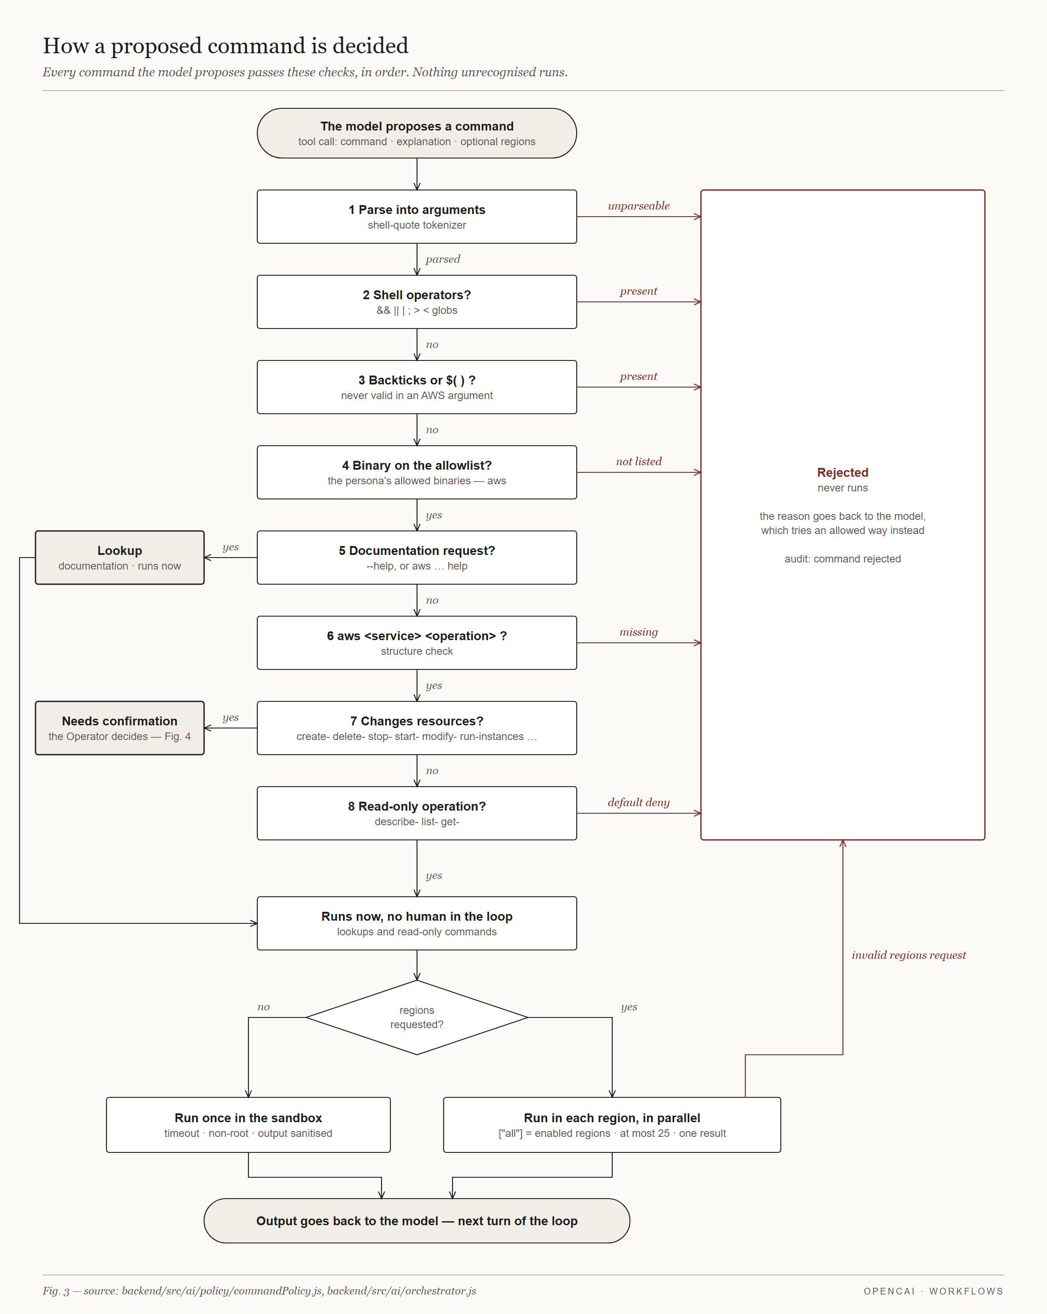
Agent Execution Flow
1. Context: resolve Organisation, Workspace, mode and chat history.
2. Sandbox: start an isolated container for the session.
3. Credentials: decrypt only this Workspace's keys; never shown to the model.
4. Persona: load the system prompt for the mode or FinOps sub-mode.
5. Model call: the model replies with text or proposes a command.
6. Policy check: deterministic code parses and classifies the command.
7. Confirmation: mutating commands wait for the Operator.
8. Execution: run in the sandbox with a timeout; sanitise the output.
9. Relay and audit: result goes back to the model; every step is logged.

Slide 10
Database description
PostgreSQL accessed through Prisma: 11 models. No external dataset is used; the system stores its own operational data.
Model | Purpose | Key fields
User | Administrator or Operator account | role, passwordHash, totpSecretEncrypted, backupCodesHashed
Organisation, UserOrganisation | Client business and which Operators may access it | name, address, phone; userId + organisationId
Workspace | Organisation -> Cloud provider -> Account -> Environment | csp, account, environment, isActive
WorkspaceCredential | Cloud access keys for one Workspace | encryptedCredentials (envelope-encrypted)
ChatSettings | Selected provider, model and limits | provider, model, sandbox timeouts, spendCeilingUsd
AgentPersona | System prompt per mode / sub-mode | modeKey, systemPrompt, allowedBinaries
ChatSession | One conversation in a Workspace | mode, subMode, sandbox state, mutatingCommandCap / Count
ChatMessage | Every message, command and result | role, kind, content, commandOutput, status
AuditLog | Independent record of every action | actor, workspace, action, outcome, metadata
InstanceBranding | White-label name, logo and login image | displayName, logoObjectKey, loginImageObjectKey

Slide 11
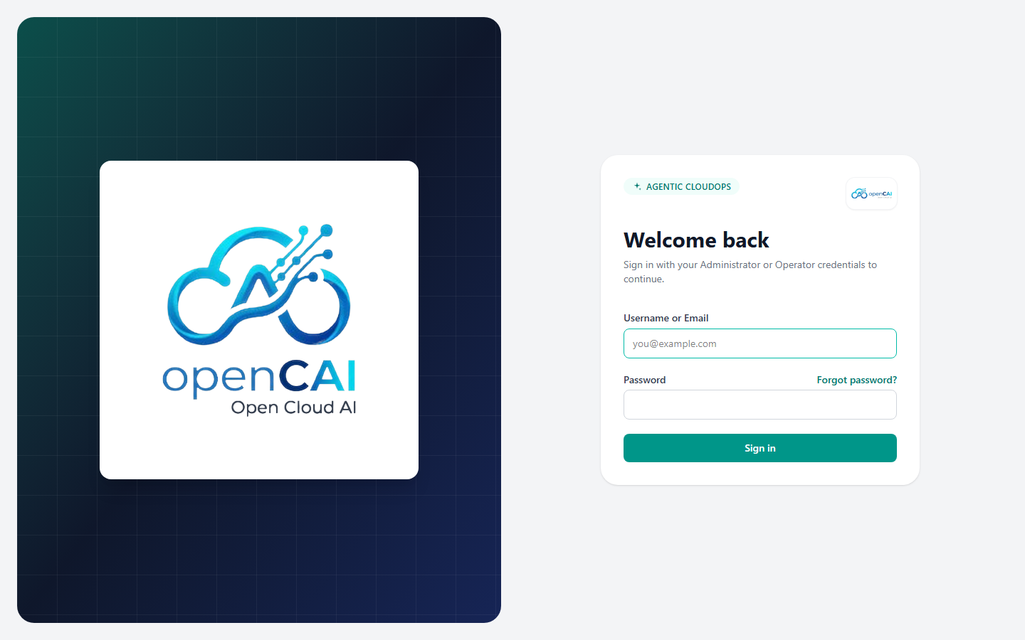
Experimental Results and Discussion
Setup: Node.js test runner on the backend; app run locally against PostgreSQL and MinIO.
Result: 245 automated tests in 21 test files, 245 passed, 0 failed (about 15 s).
Covered: command policy, output sanitiser, sandbox manager, agent orchestrator, five provider adapters, envelope encryption, admin and chat services.
Policy behaviour: shell operators, command substitution and non-allowlisted binaries are rejected; mutating commands always wait for confirmation.
User testing: shared with real users for hands-on testing; their AIOps and FinOps sessions ran real AWS CLI commands on a Workspace (next slide).
OpenCAI sign-in screen (local run)

Slide 12
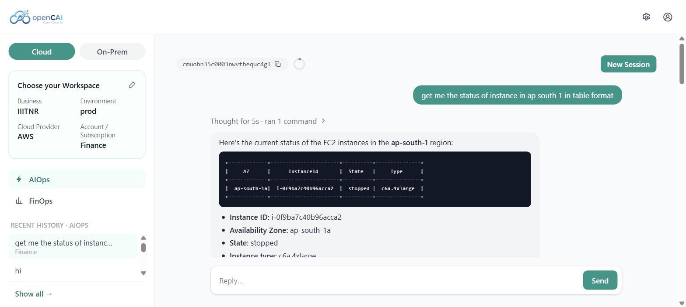
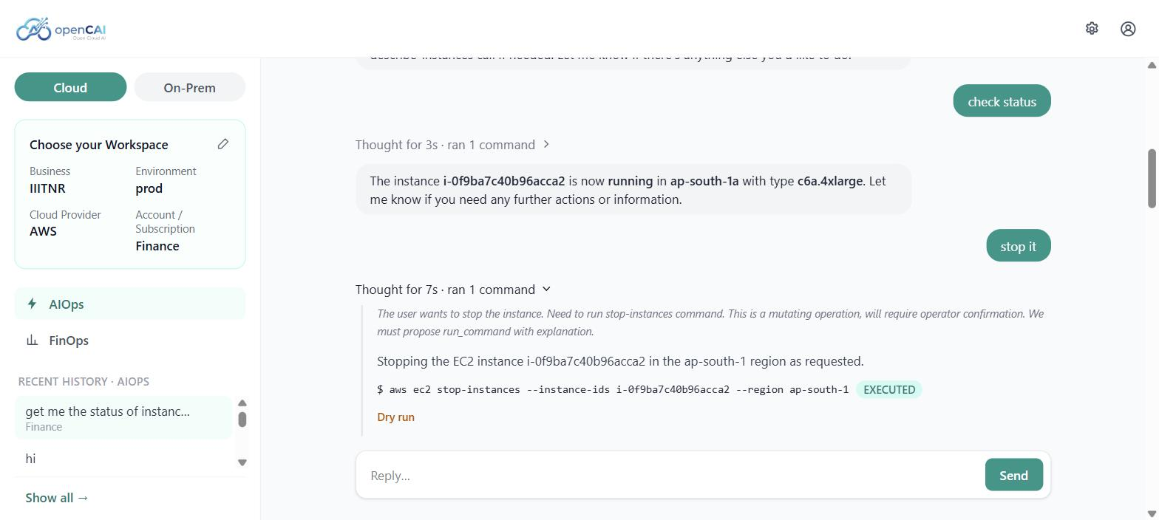
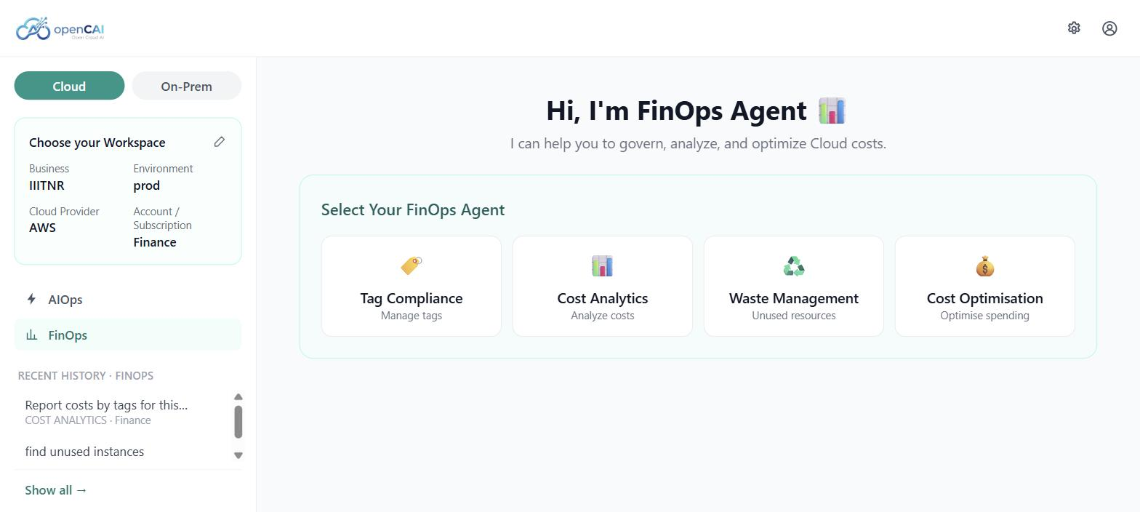
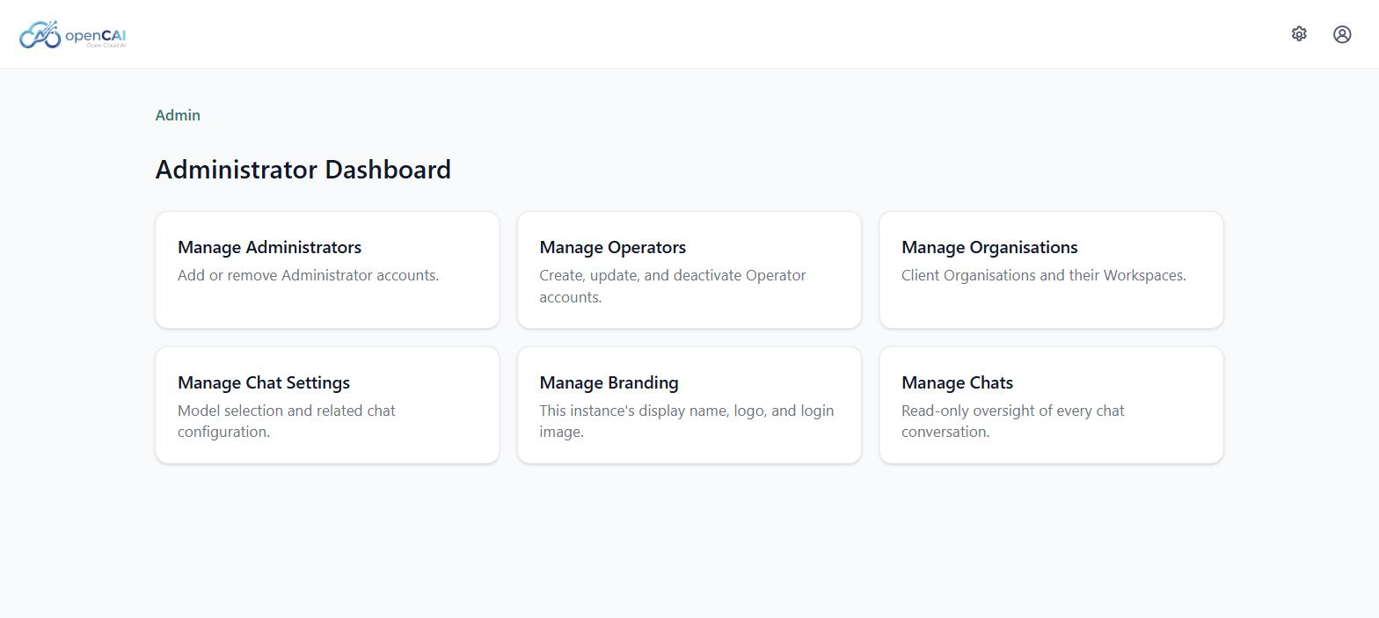
Results: Application Screenshots
AIOps: read-only command run on an AWS Workspace
Mutating command (stop-instances) shown as EXECUTED
FinOps: four sub-mode agents
Administrator dashboard

Slide 13
Conclusion and Future Directions
OpenCAI lets Operators run cloud operations and cost analysis from chat, on a self-hosted, white-label platform.
Safety comes from the layer around the model: default-deny policy, human confirmation, sandboxing, sanitised output and audit.
The stack (React, Node.js, PostgreSQL, Docker) is containerised and released automatically with semantic versioning.
Future directions:
  On-Prem mode: extend the platform beyond public cloud to on-premises infrastructure.
  Improved guardrails: restrict sandbox network egress and enforce the per-session spend ceiling.
  Data backup: the database currently runs on the same VM as the application; add scheduled, off-host backups.

Slide 14

Thank You
..
Dr. Shyama Prasad Mukherjee International Institute of Information Technology, Naya Raipur

